Slide 1

Yangtian Yan (System Application Engineer)
High-Precision Temperature Measurement System Based on ADUCM360 Integrated with Temperature Compensation Algorithm

Slide 2
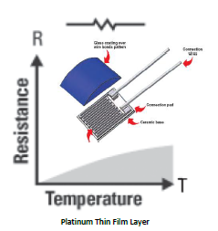
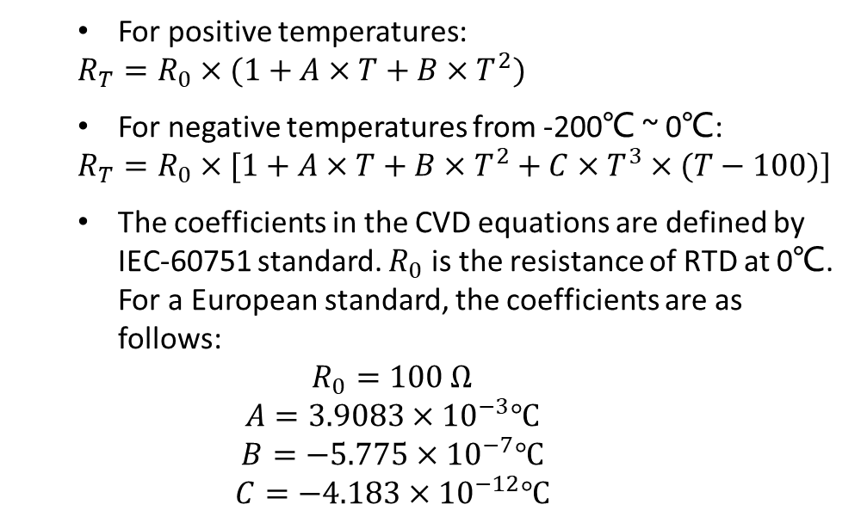
Background / RTD
Resistance Temperature Detector (RTD) Overview
Most stable, most accurate, rugged easy to connect and implement. Great temperature range -240℃ ~ 650℃.
For positive temperatures:
$$R_{T}=R_{0}×(1+A×T+B×T^{2})$$
For negative temperatures from -200℃ ~ 0℃:
$$R_{T}=R_{0}×[1+A×T+B×T^{2}+C×T^{3}×(T−100)]$$
The coefficients in the CVD equations are defined by IEC-60751 standard. $R_{0}$ is the resistance of RTD at 0℃. For a European standard, the coefficients are as follows:
$$R_{0}=100 Ω$$
$$A=3.9083×{10}^{−3}℃$$
$$B=−5.775×{10}^{−7}℃$$
$$C=−4.183×{10}^{−12}℃$$
Figure 1 . Pt100 RTD Resistance from -200℃ to 800℃
Approximate Expression
ΔT=ΔR/0.385
T represents the measuring temperature
ΔT represents the change of measuring temperature value

Slide 3
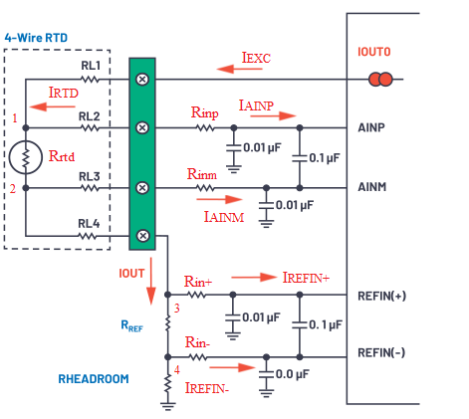
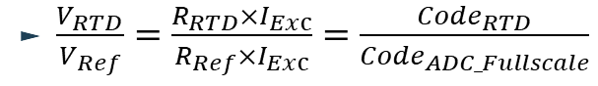

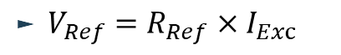
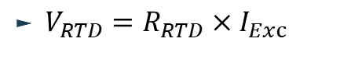
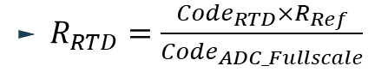
System configuration / Parameter selection
RTD 4-Wire Configuration
1. “ How to Select and Design the Best RTD Temperature Sensing System ”
2. “ Thermistor-Based Temperature Sensing System—Part 1: Design Challenges and Circuit Configuration ”
$R_{MRTD}≈k_{1}{×R}_{RTD}=\frac{I_{EXC}−I_{AINP}}{I_{EXC}−I_{AINP}−I_{AINM}−I_{REFIN+}}{×R}_{RTD}$
$R_{ERROR}≈k_{2}{×R}_{RTD}=\frac{I_{AINM}+I_{REFIN+}}{I_{EXC}−I_{AINP}−I_{AINM}−I_{REFIN+}}$ ${×R}_{RTD}$
$T_{ERROR}≈\frac{R_{ERROR}}{0.385}$
The ratiometric measurement method
$V_{RTD}=R_{RTD}×I_{Exc}$
$V_{Ref}=R_{Ref}×I_{Exc}$
ADUCM360
$\frac{V_{RTD}}{V_{Ref}}=\frac{R_{RTD}×I_{Exc}}{R_{Ref}×I_{Exc}}=$ $\frac{{Code}_{RTD}}{{Code}_{ADC_Fullscale}}$
$R_{RTD}=\frac{{Code}_{RTD}×R_{Ref}}{{Code}_{ADC_Fullscale}}$
feature | Configuration
External Reference | Enable
VREF+ | Selected as buffer inputs
VREF- | Selected as buffer inputs
Headroom Resistor | 150Ω(0.1% 10PPM/℃)
Reference Resistor | 2.5kΩ(0.1% 10PPM/℃)
ADC Mode | Timer trigger single ADC conversion mode /ADC DMA mode
feature | Configuration
Gain | 4
Filter | Sin3
Current | 1mA/50uA

Slide 4
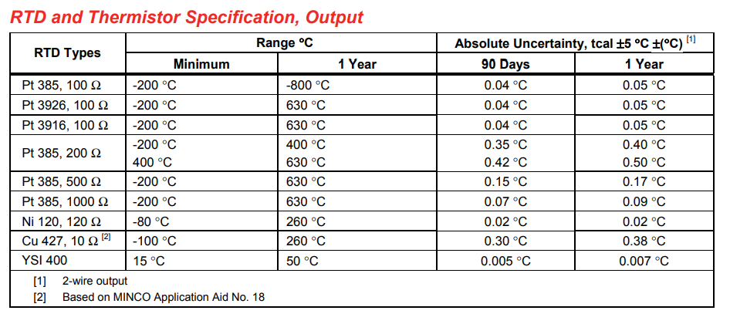
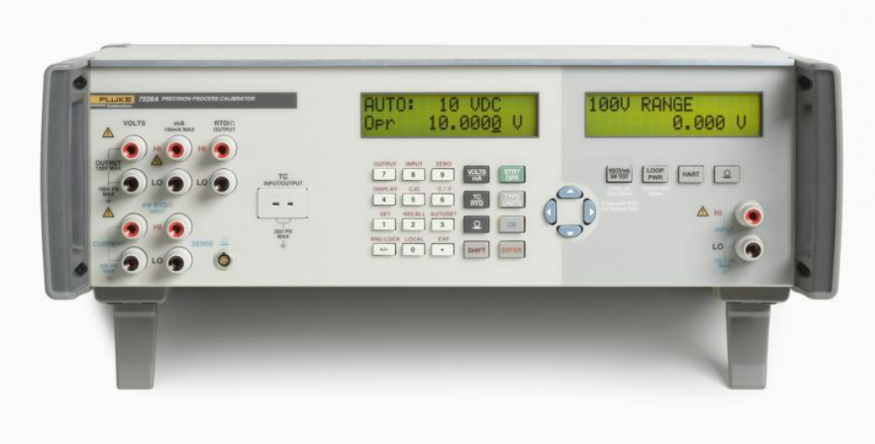
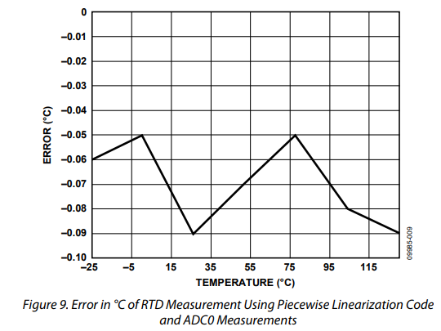
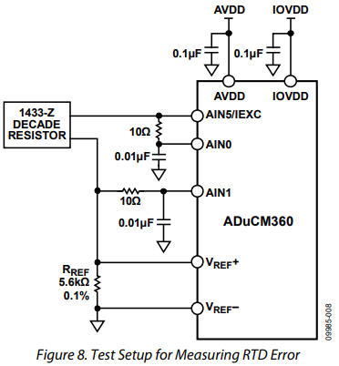
Calibration Measurement / Comparison of different Solutions
Test Equipment
FLUKE 7625A
Test Result (1mA)
The schematic and test result of Demo CN0221
Comparison of Test result (1mA) and measurement result of CN0221 (200uA)

Slide 5
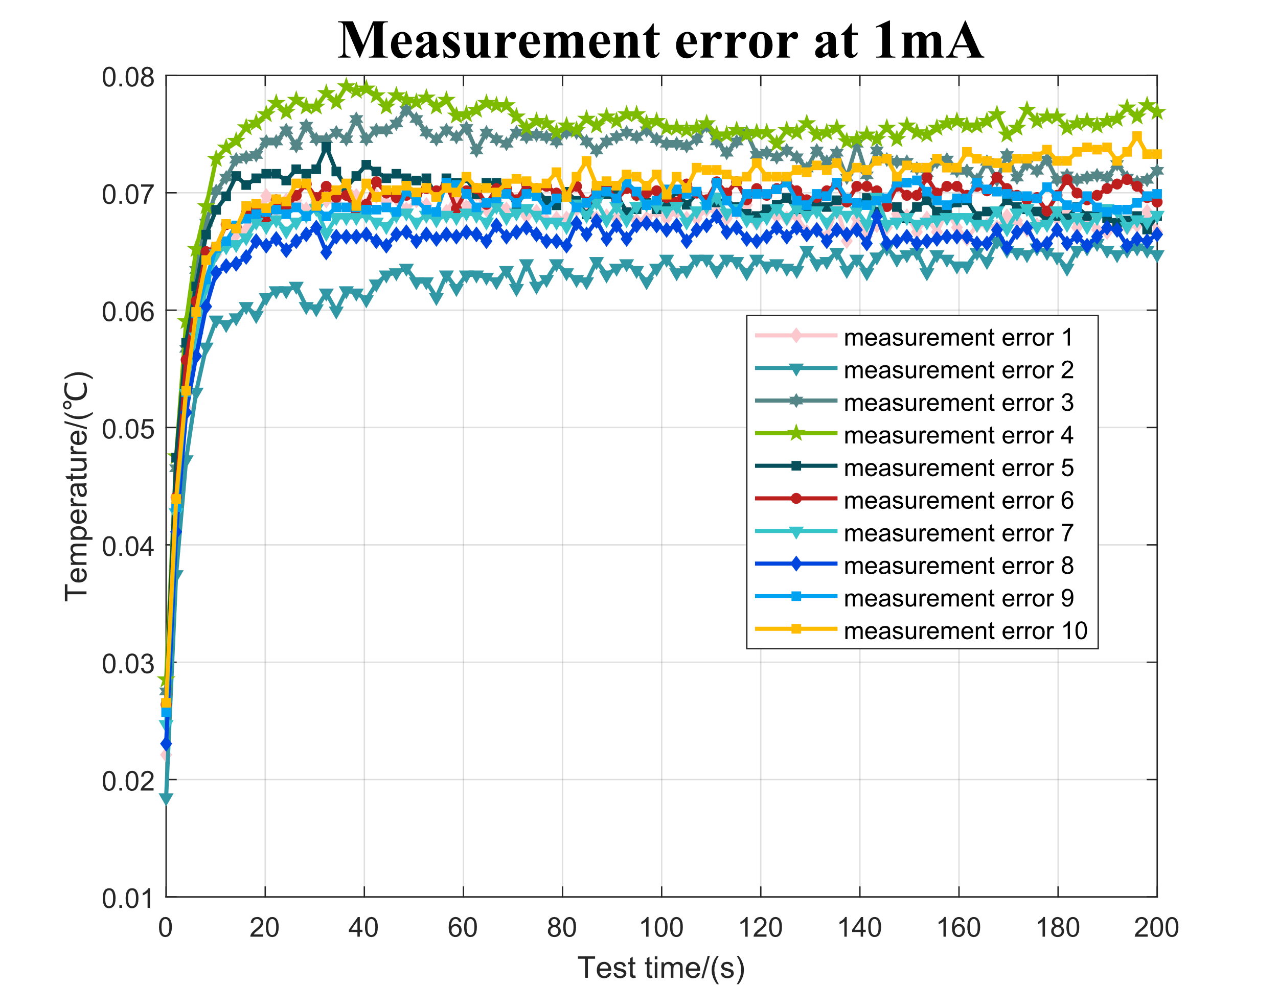
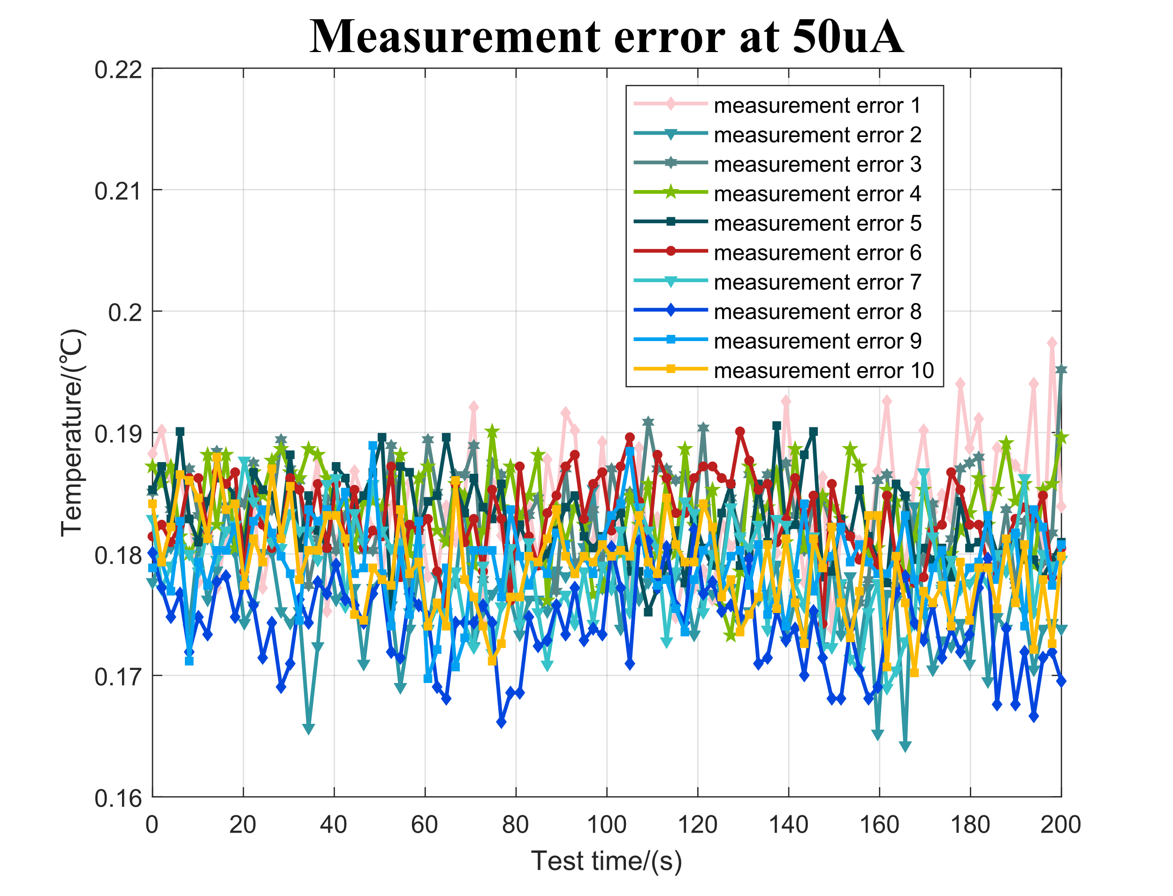
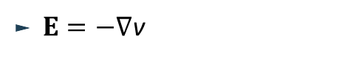
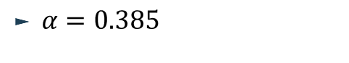

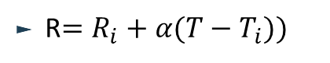

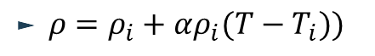
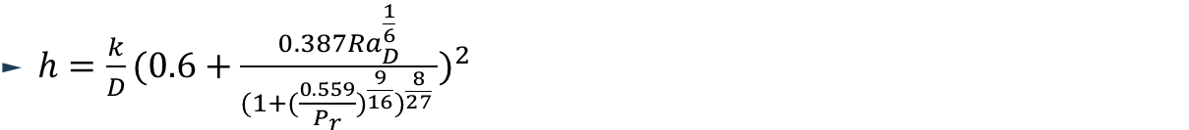
RTD Measurement / Self-heating Calculation
Using 1mA/50uA Excitation Current with Class AA RTD
to measure the water temperature
By designing a multi-physics coupling model involving fluid dynamics, fluid-solid heat transfer, and electrothermal processes, we can compute and predict the temperature rise of the RTD resistor.“
The temperature/heat transfer field governing equation
Current value | Configuration | Reference voltage
1mA | Gain=4，reference resistor=2.5kΩ, | 2.5V
50uA | Gain=128, reference resistor=50kΩ | 2.5V
$ρc_{p}\frac{∂T}{∂t}+Δ∙\left(ρc_{p}uT\right)−∇∙\left(k∇T\right)=Q+Q_{ted}$
$q_{0}=h(T_{ext}−T)$
$h={\frac{k}{D}(0.6+\frac{0.387{Ra}_{D}^{\frac{1}{6}}}{{(1{+(\frac{0.559}{P_{r}})}^{\frac{9}{16}})}^{\frac{8}{27}} })}^{2}$
The fluid/laminar field governing equation
$\frac{∂p}{∂t}+∇∙\left(ρu\right)=0$
$ρ\frac{∂u}{∂t}+ρ\left(u∙∇\right)u=∇(−ρI+K)+F$
Fig.1
Fig.2
$K=μ(∇u+{\left(∇u\right)}^{T})$
The electric current field governing equation
Measurement error analysis
Current value | Maximum measurement error | Self-heating error
1mA | 0.0799℃ | 0.051℃
50uA | 0.196℃ | 0.015℃
$∇∙J=Q_{j,v}$
$ρ=ρ_{i}+αρ_{i}(T−T_{i}))$
$J=σE+\frac{∂D}{∂t}+J_{e}$
R$=R_{i}+α(T−T_{i}))$
$E=−∇$v
$α=0.385$

Slide 6
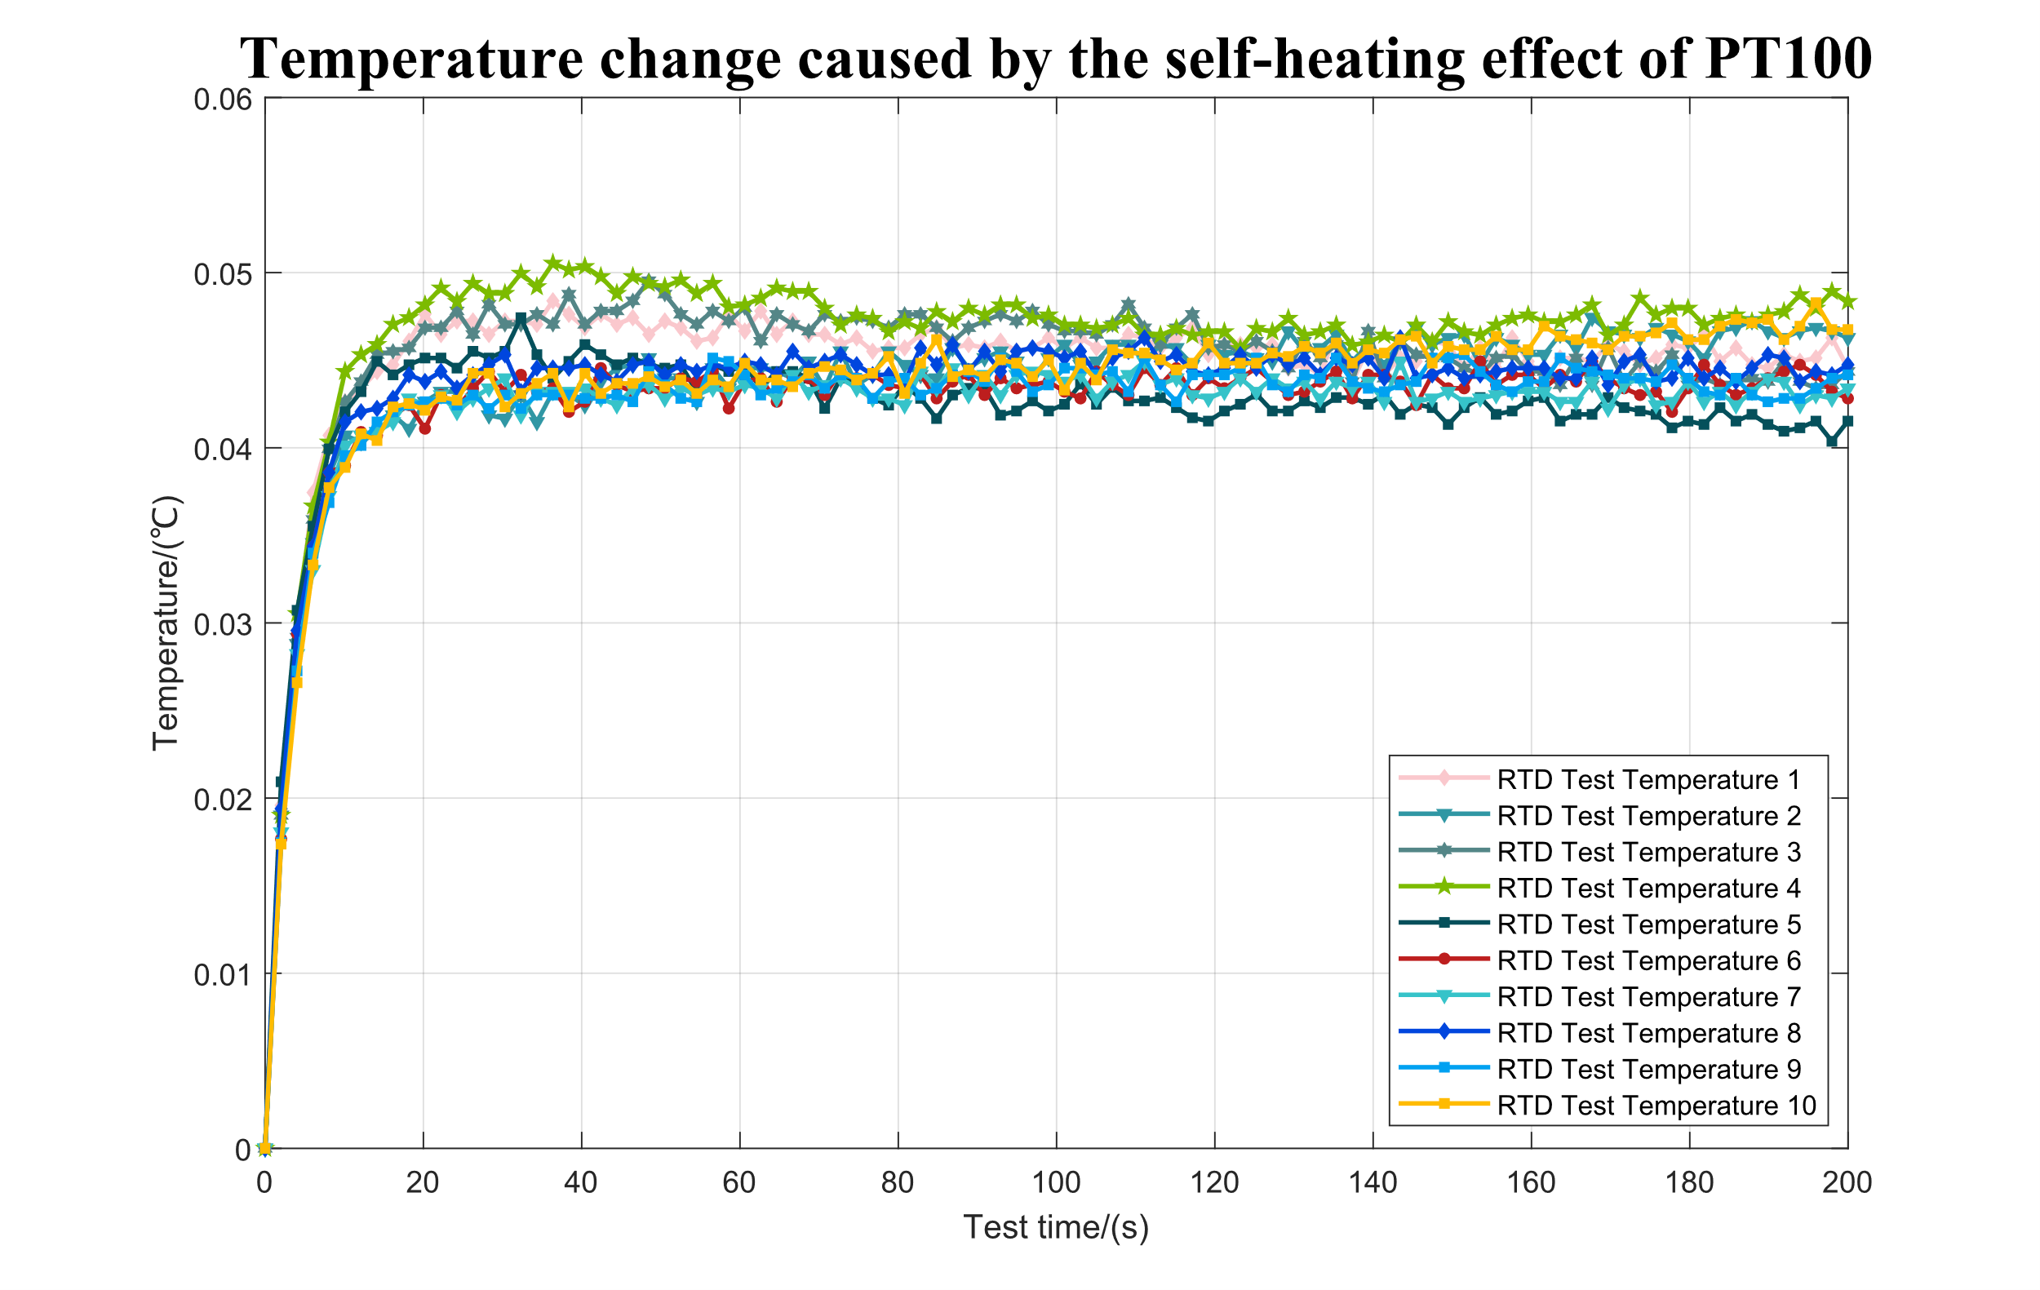
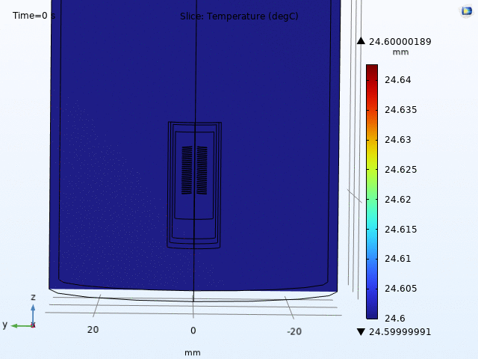
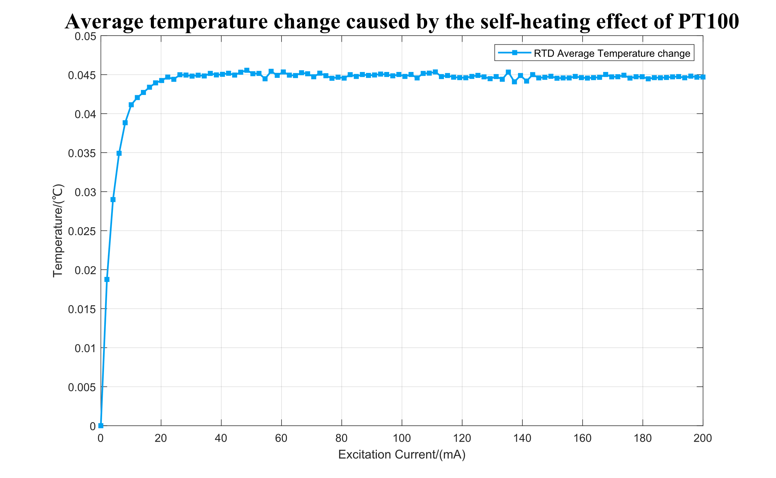
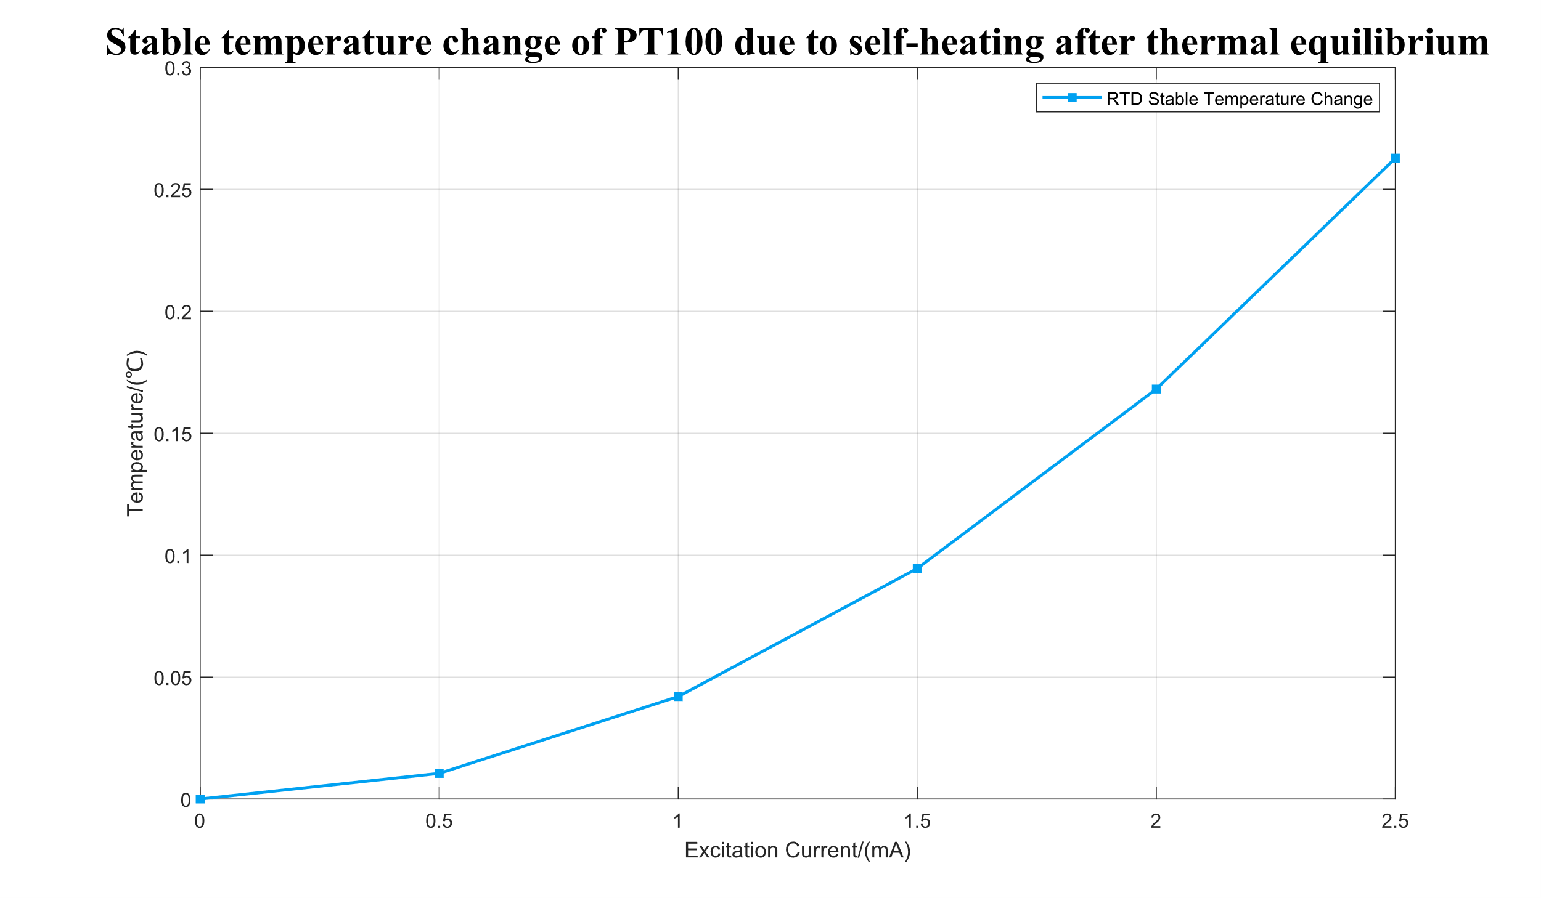
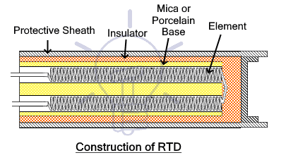
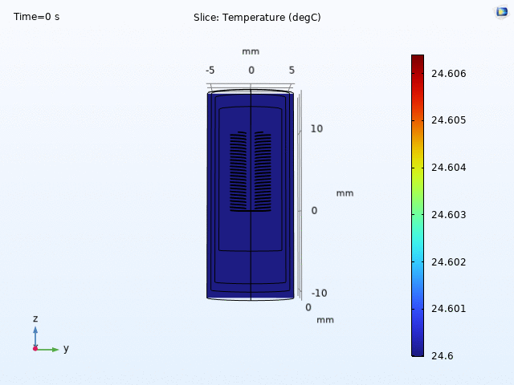
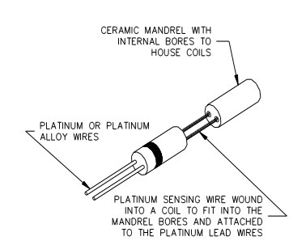
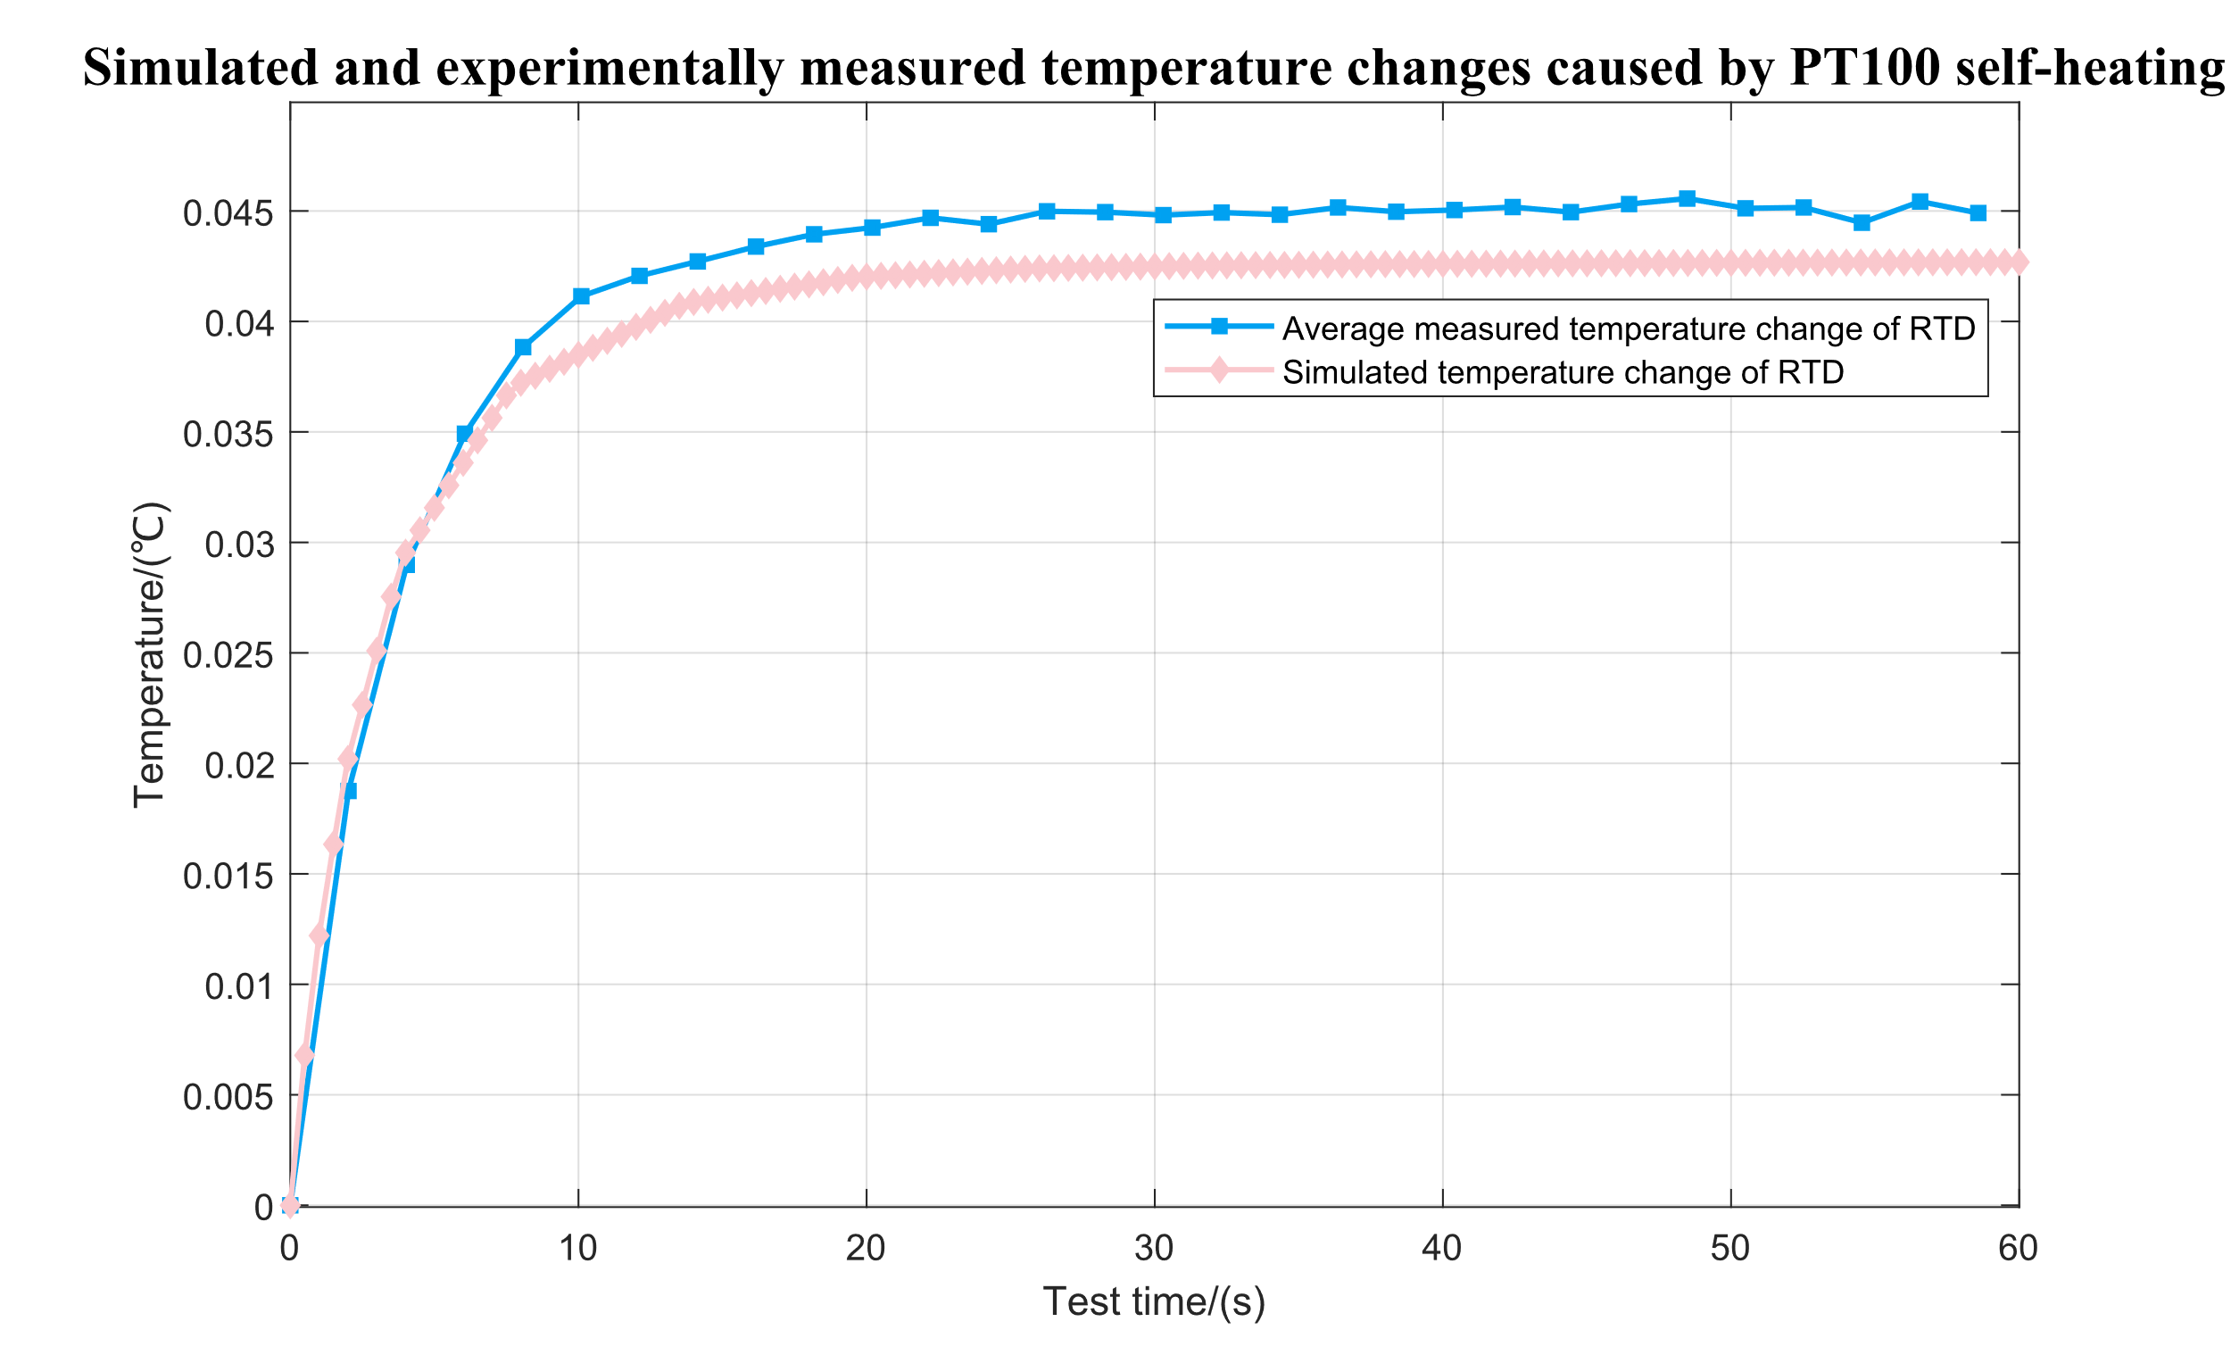
Simulation model Design and Accuracy Verification
Fig. 6
Fig.9
Fig.1
Fig.4 Continuous mode (1mA)
Fig.7
Fig.2
Fig.10
Fig.3
Fig.8
Fig.5 Discontinuous mode (current=1mA) sampling period=20.6s
Current source turn-on duration=600ms
Current source turn-off duration= 20s
Mode Design
Continuous mode test/simulation comparison
Fig.11

Slide 7
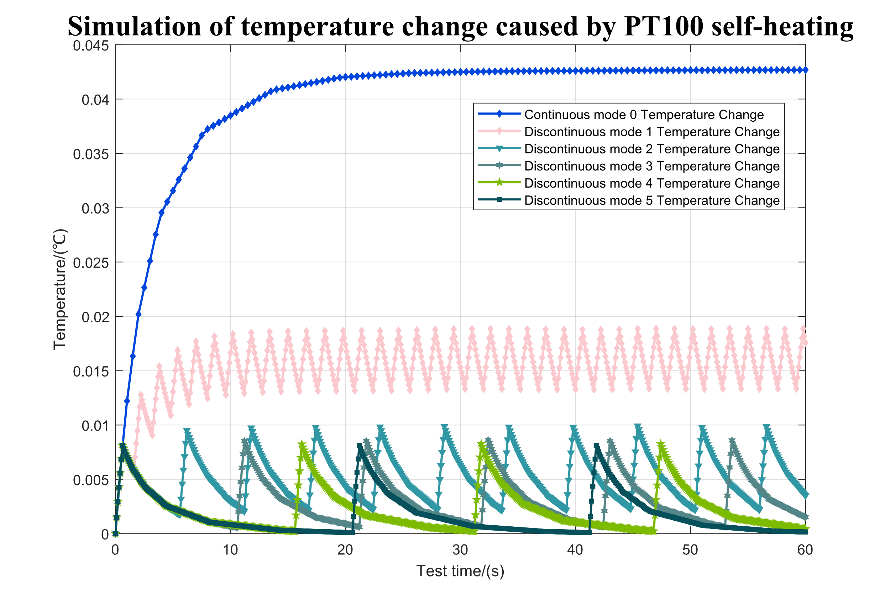
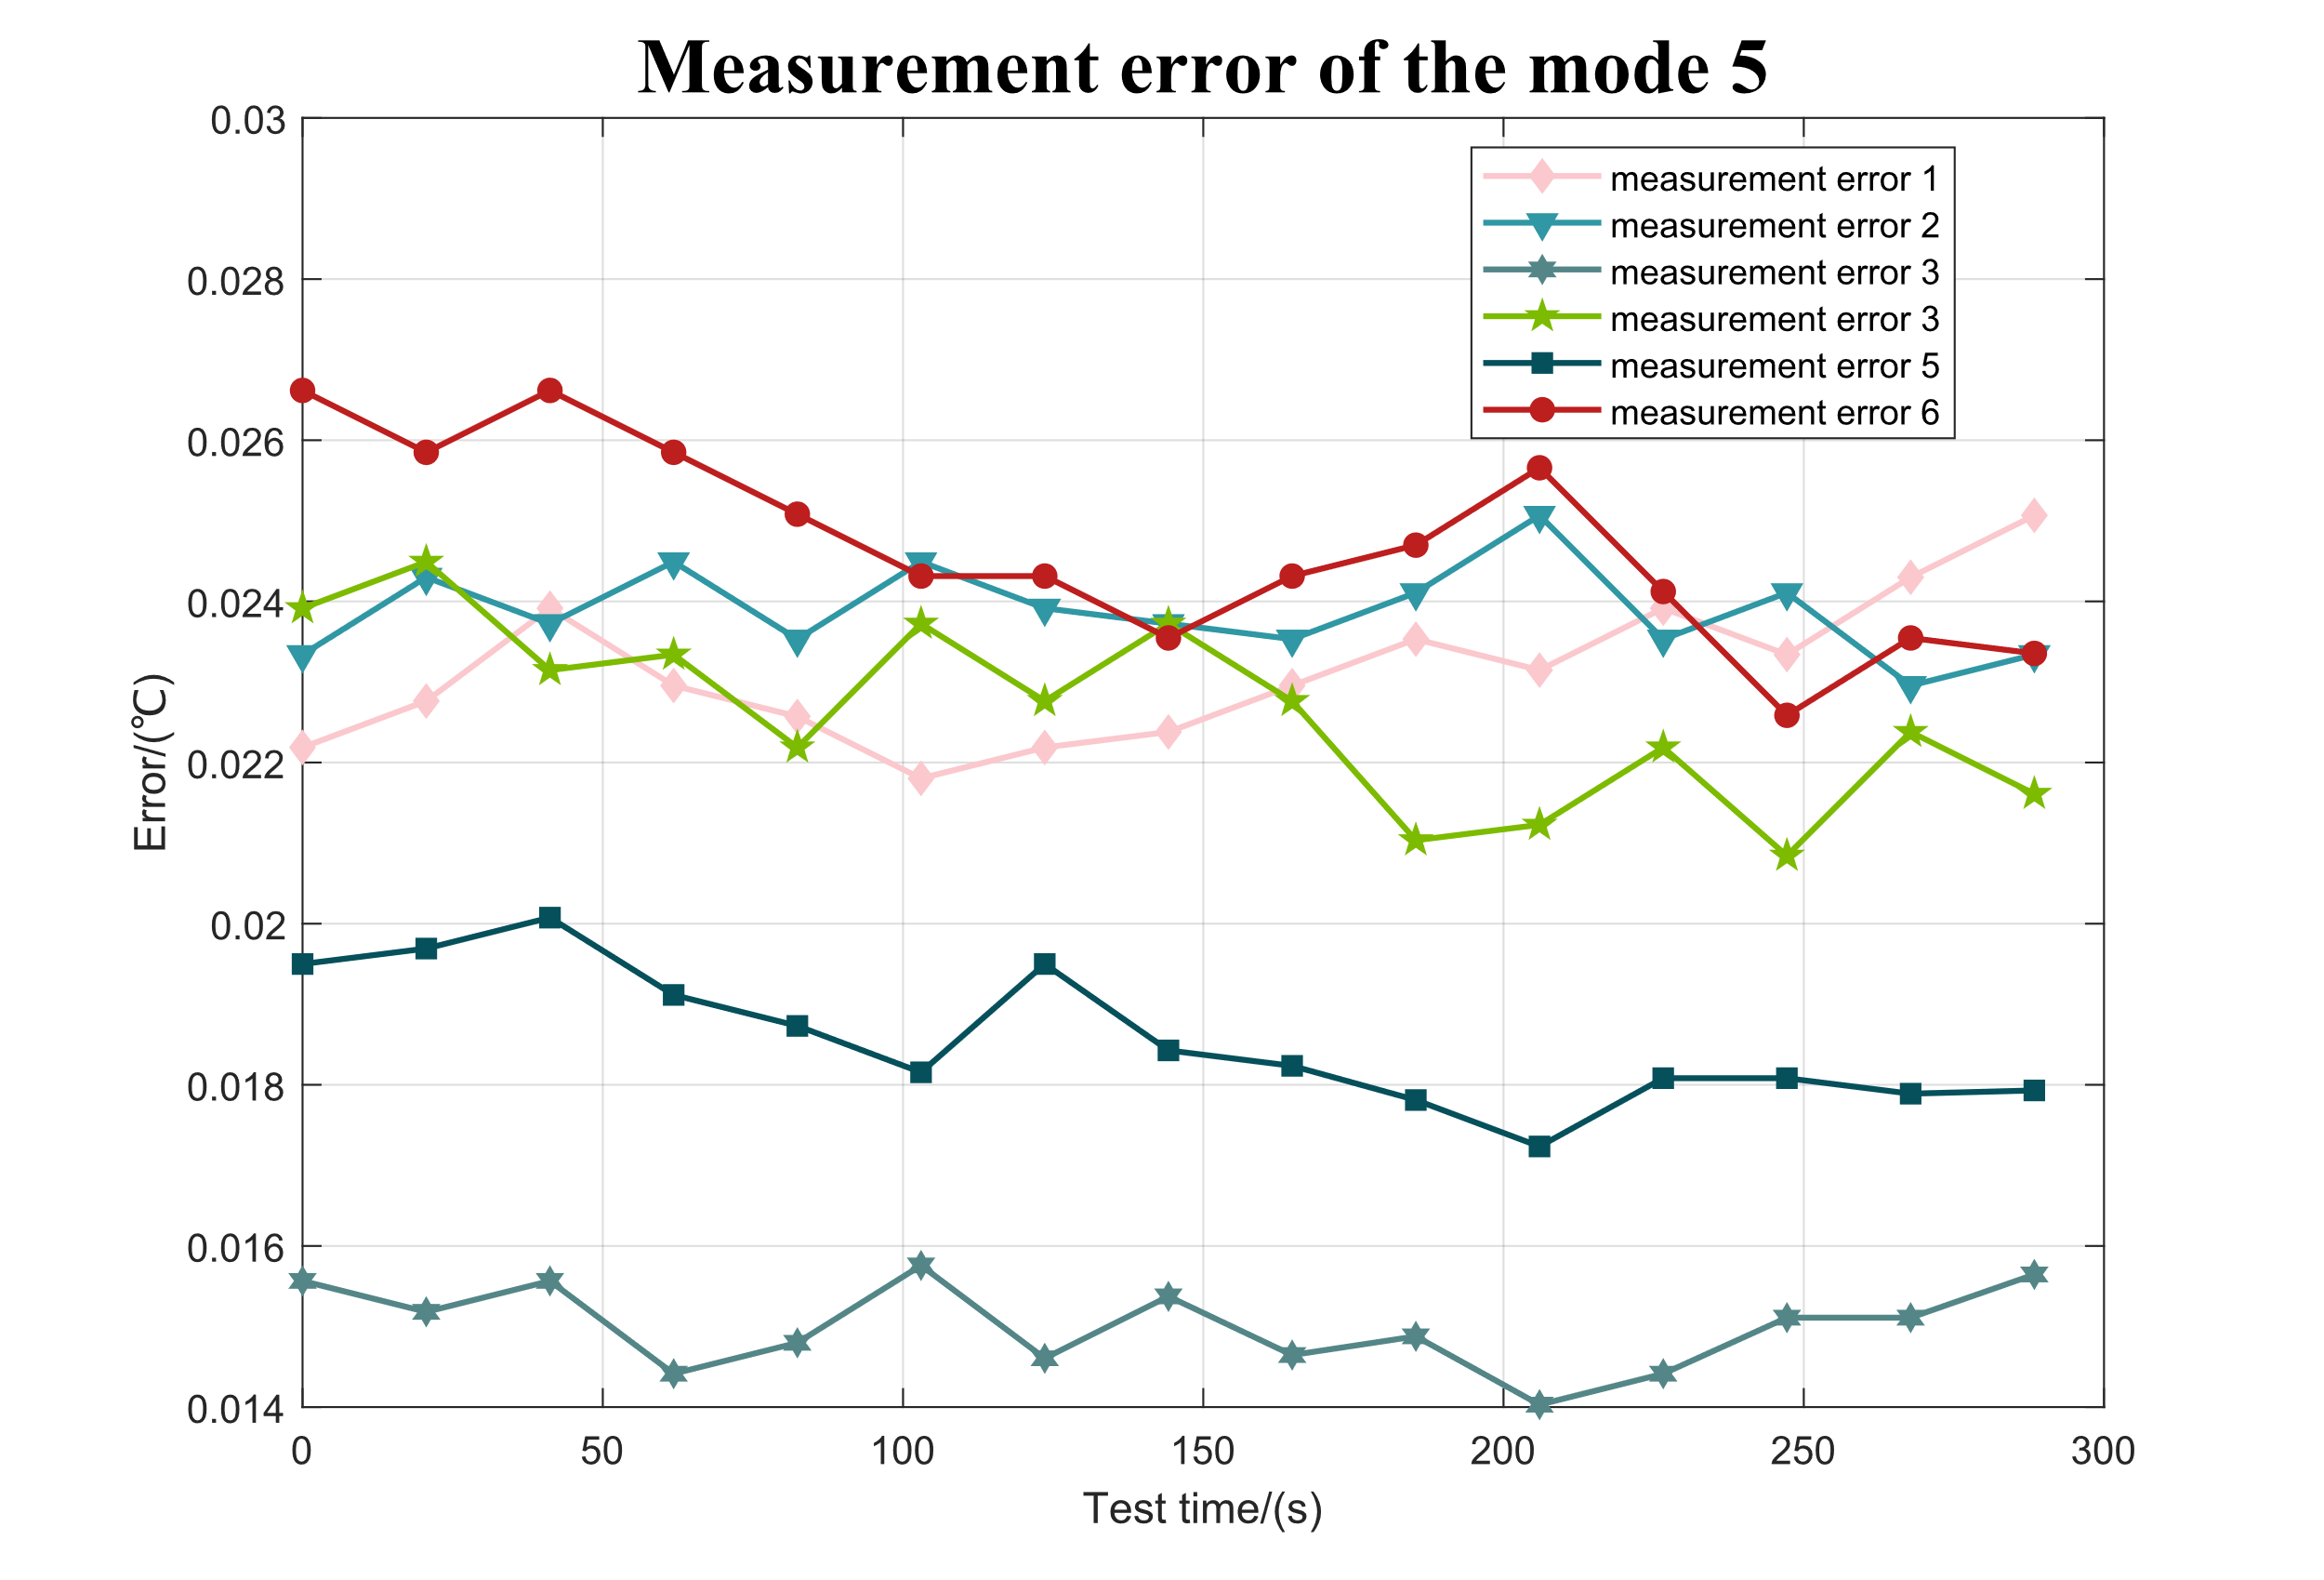
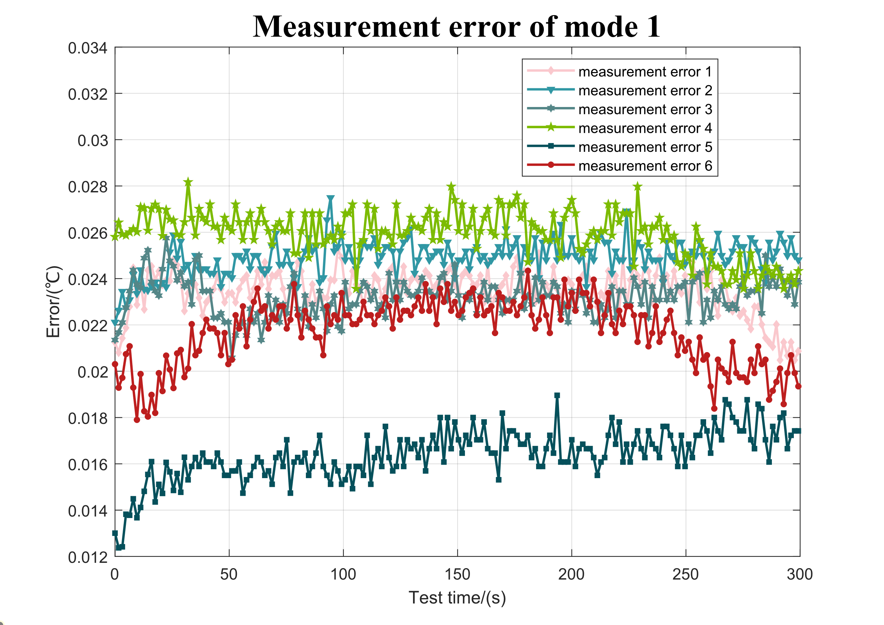
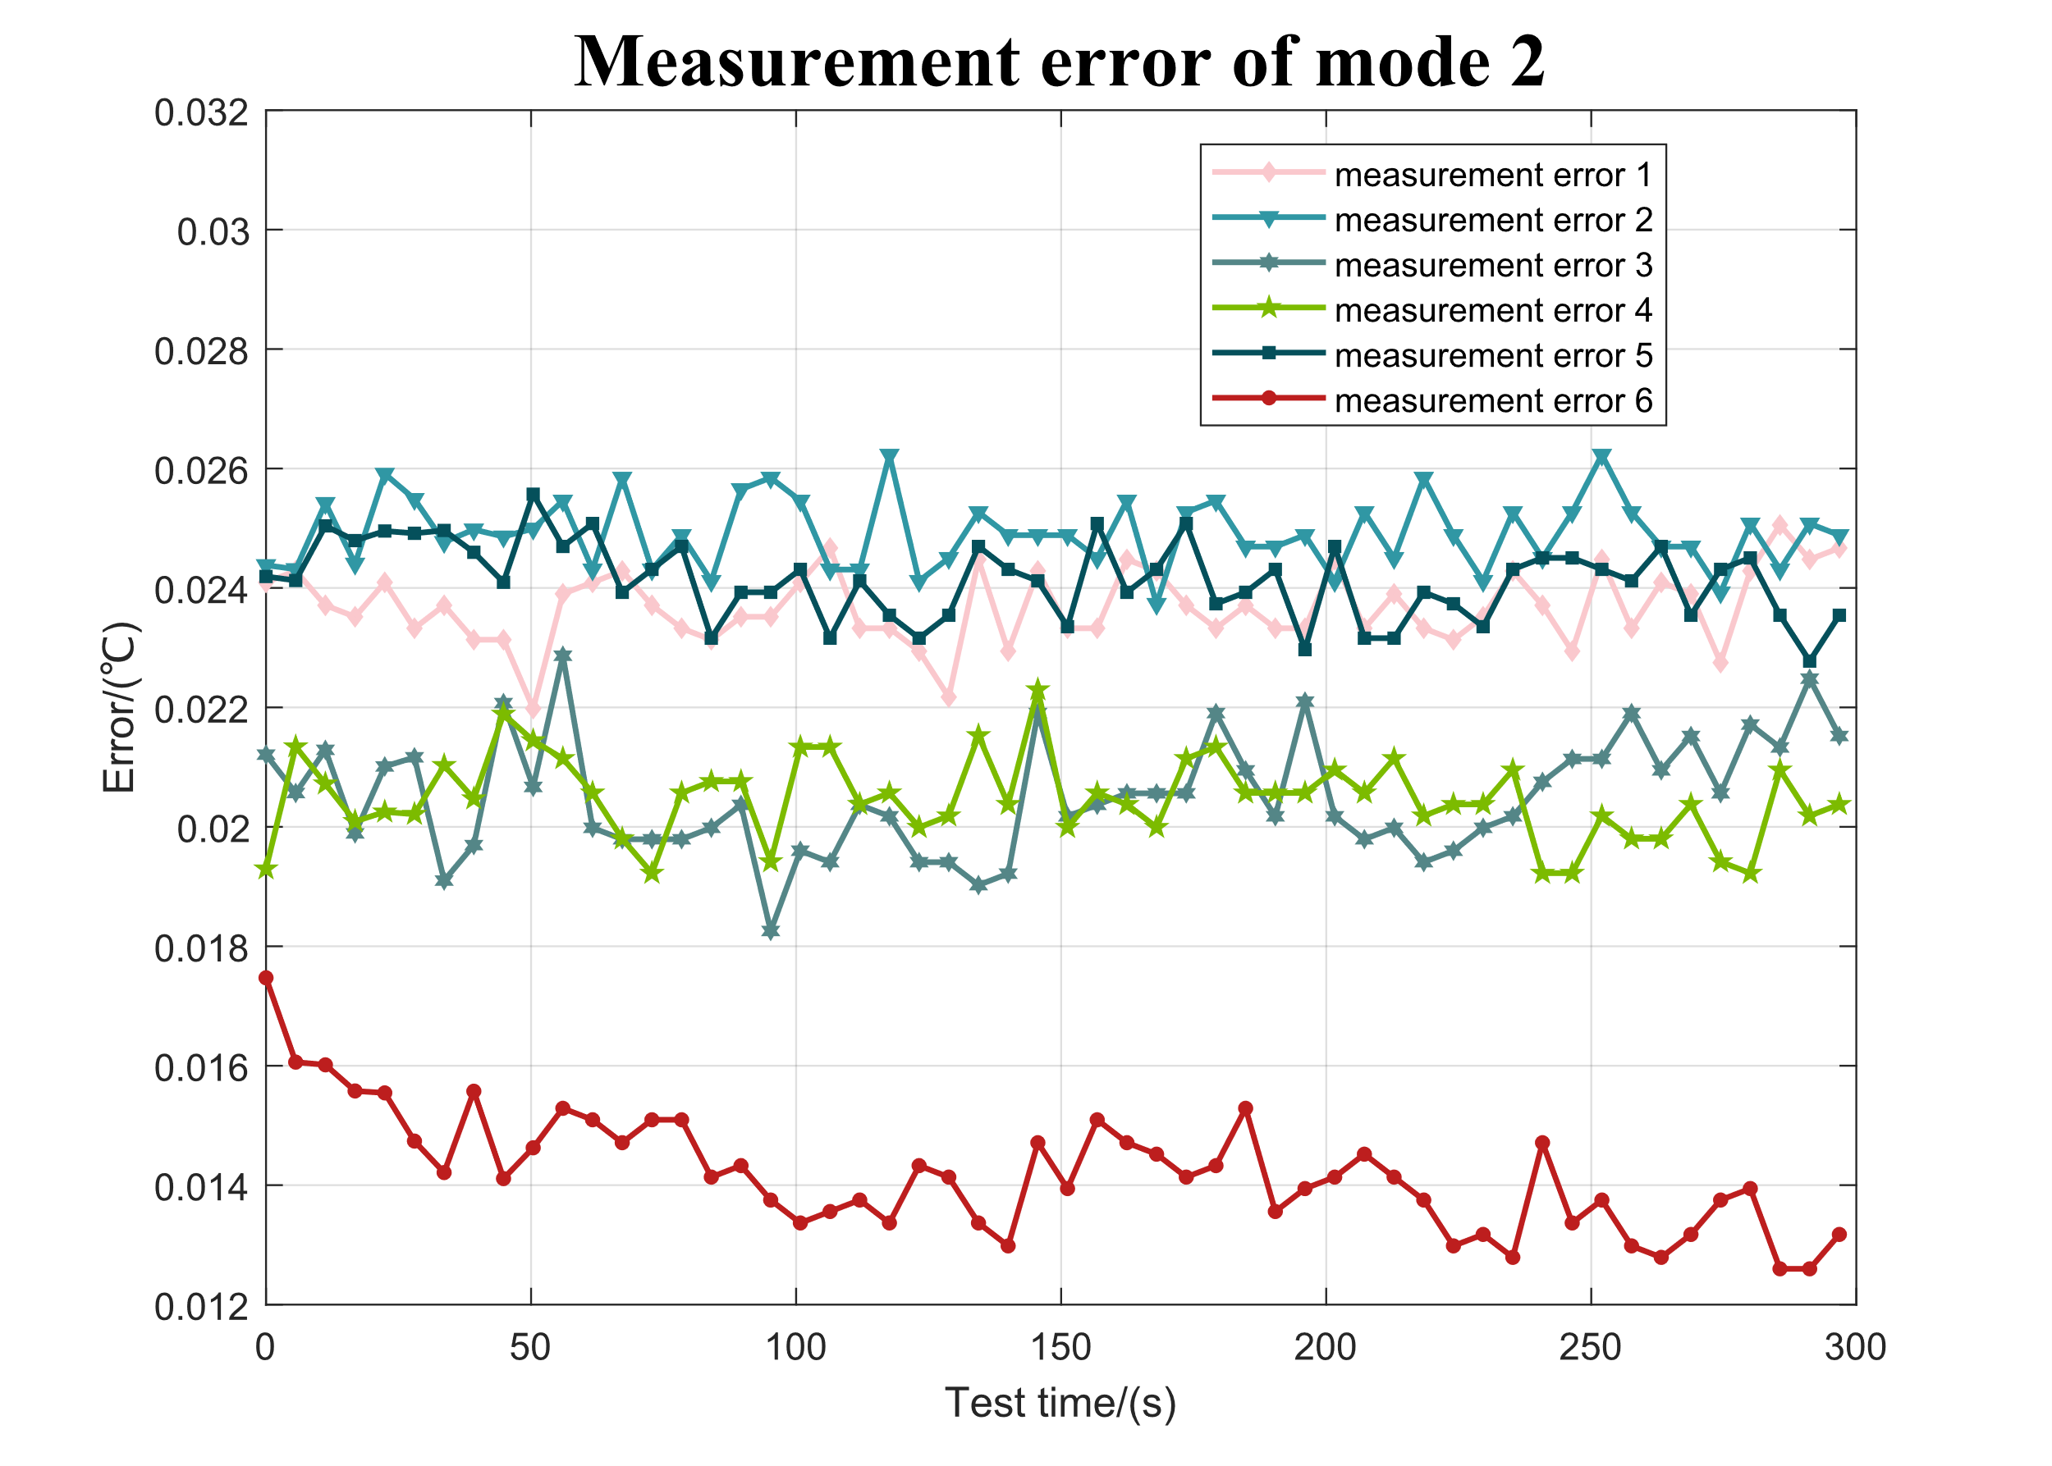
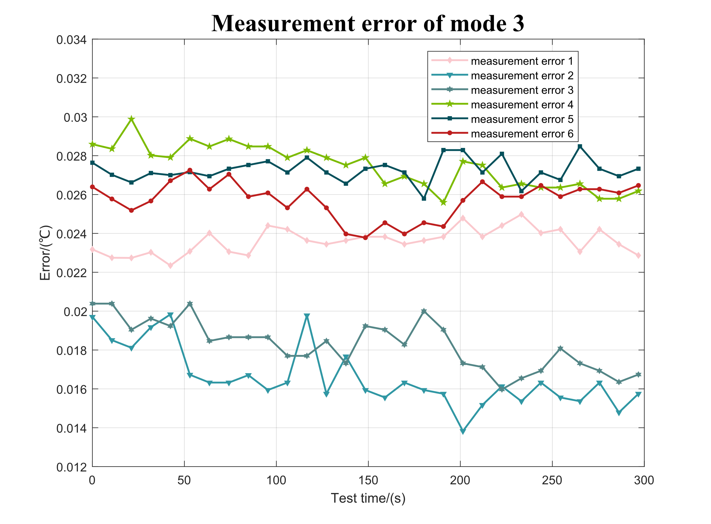
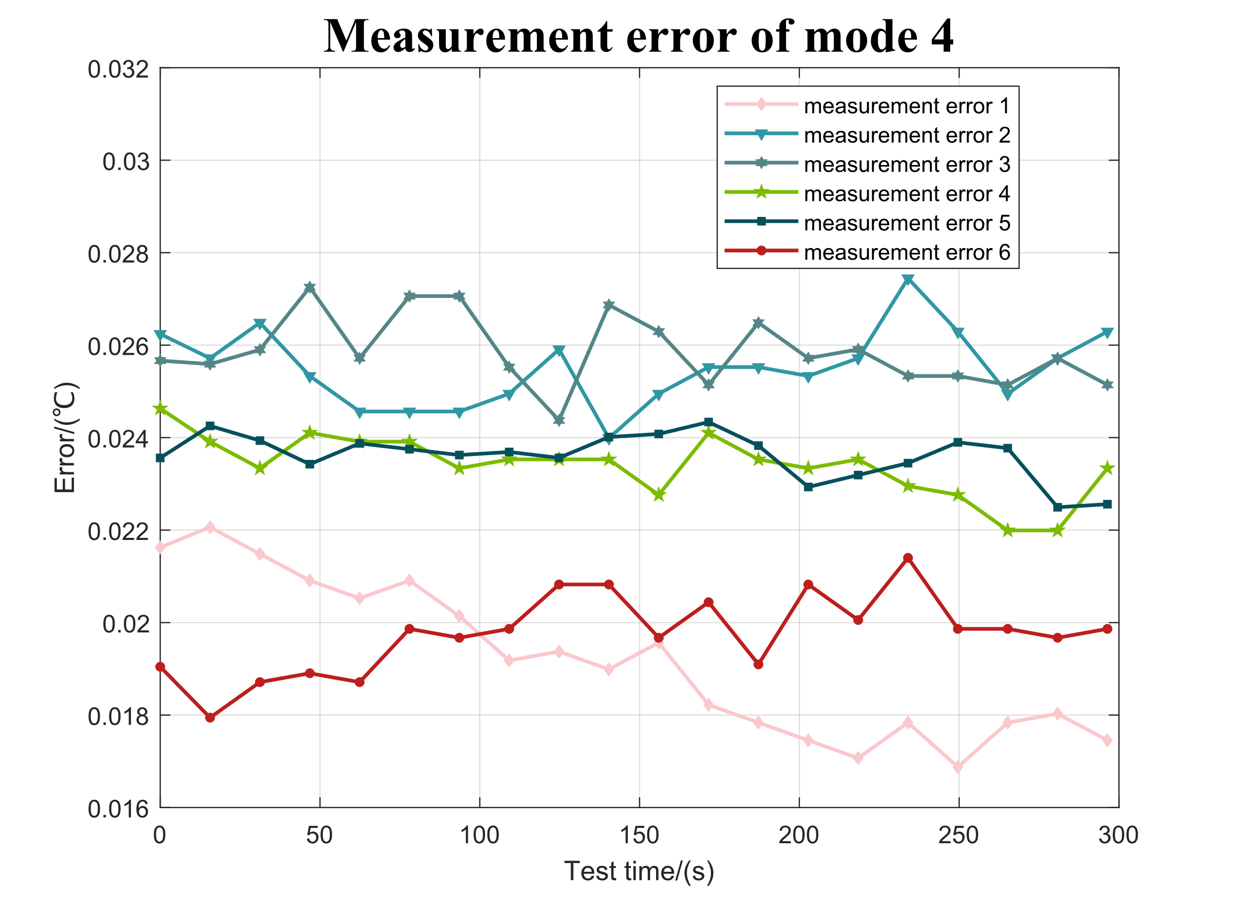
Final test results using the compensation algorithm
Six measurement mode with self-heating prediction curve
Fig.1
Fig.2 Measured results of different current duty cycles
In all 5 modes, the maximum error is less than 0.03℃
By using the compensation algorithm.
Fig.3 Discontinuous mode 1 result
Fig.4 Discontinuous mode 2 result
Fig.5 Discontinuous mode 3 result
Fig.6 Discontinuous mode 4 result

